Slide 1

Modified Early Warning Score (MEWS)
Score | 3 | 2 | 1 | 0 | 1 | 2 | 3
SpO2 | <85 | 85-89 | 90-94 | >95
RR |  | <8 |  | 9-14 | 15-20 | 21-29 | >30
Pulse | <30 | 31-40 | 41-50 | 51-100 | 101-110 | 111-129 | >130
SBP | <70 | 71-80 | 81-100 | 101-180 | 181-200 | 201-219 | >220
Urine |  | <20ml/hr | <35ml/hr |  | >200ml/hr
BT (C) |  | <35 | 35.1-36.0 | 36.1-37.3 | 37.4-38.4 | >38.5
CNS |  | Confuse | Agitate | Alert | Verbal response | Response to pain | Unresponsive

Slide 2
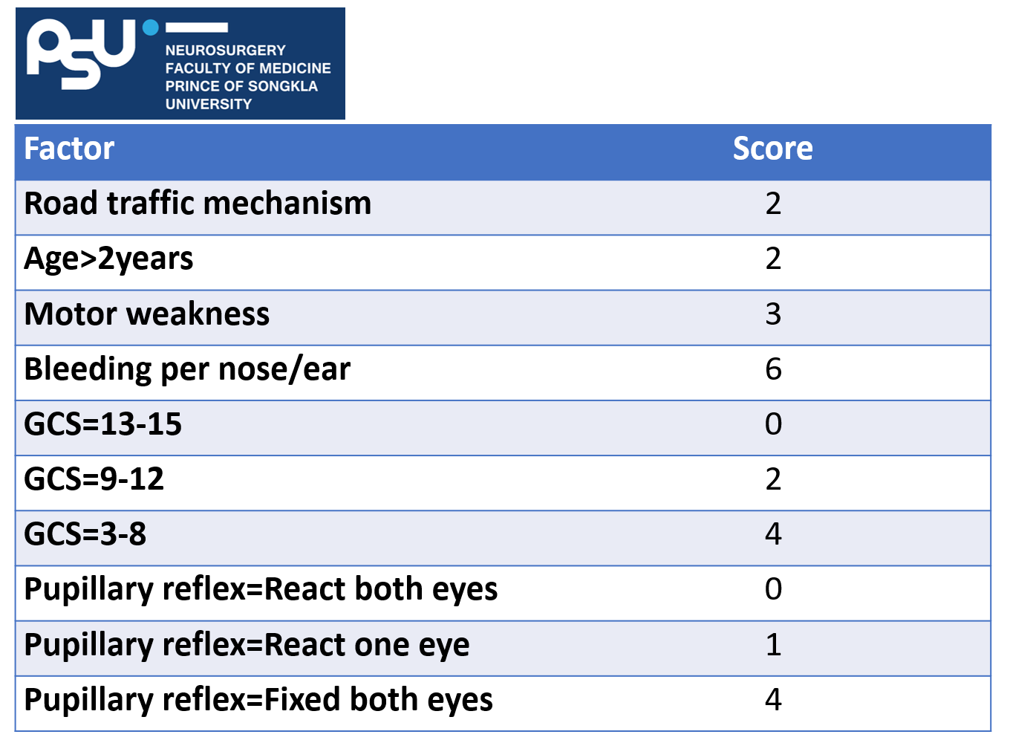
Factor | Score
Road traffic mechanism | 2
Age>2years | 2
Motor weakness | 3
Bleeding per nose/ear | 6
GCS=13-15 | 0
GCS=9-12 | 2
GCS=3-8 | 4
Pupillary reflex=React both eyes | 0
Pupillary reflex=React one eye | 1
Pupillary reflex=Fixed both eyes | 4

Slide 3
Predicted
positive finding
Score >3
Yellow Zone
MEWS 3-5
Predicted negative finding
Score 0-2

Slide 4
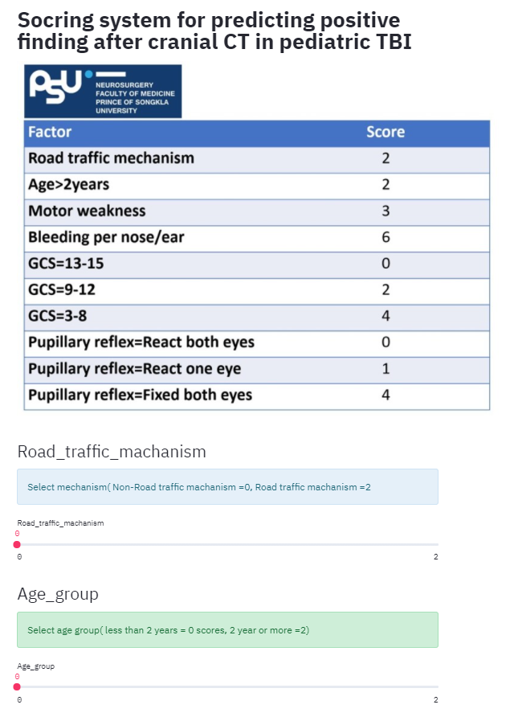
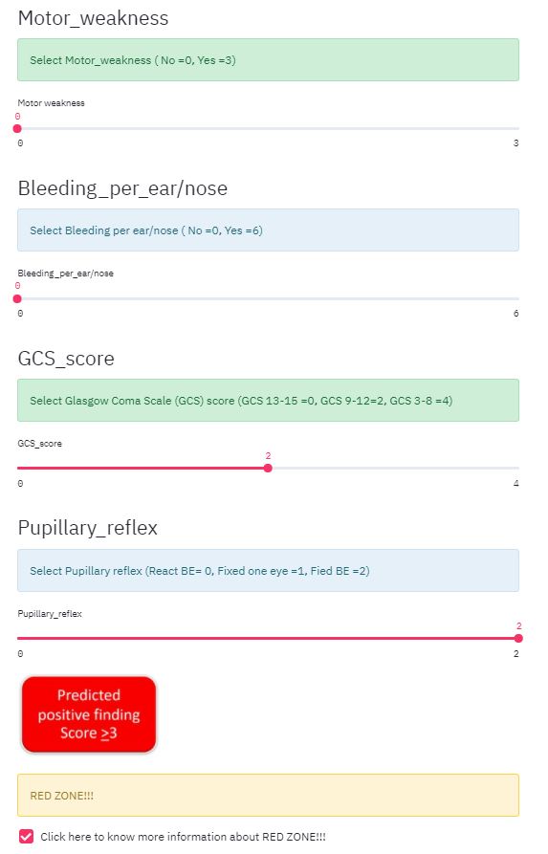
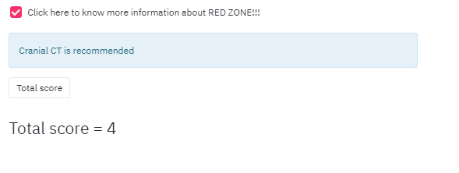

Slide 5
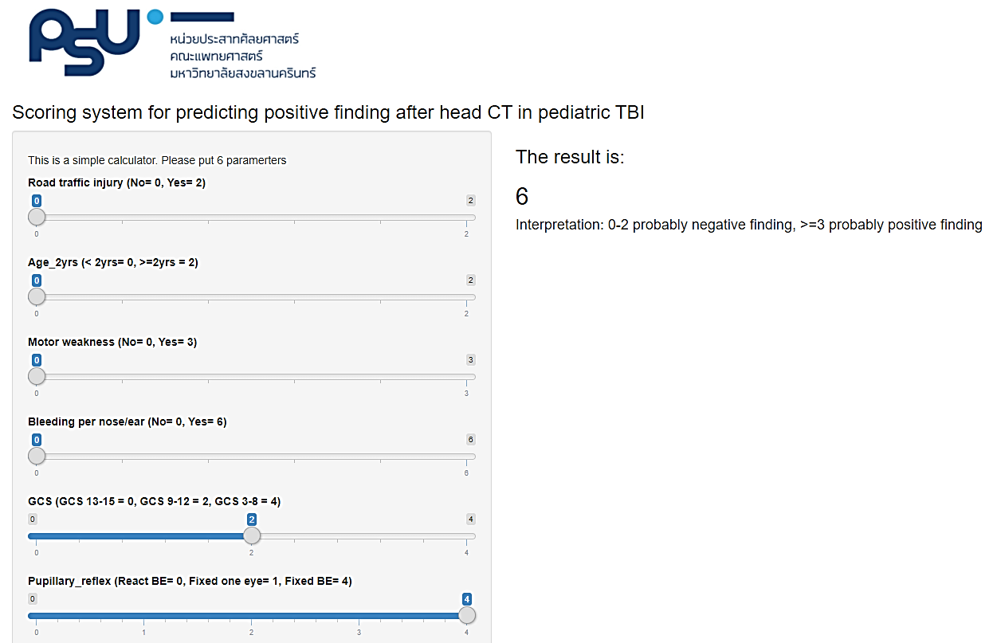

Slide 6



